Slide 1




FareSunday
Holiday Package
Dokumen Laporan Final Project - Stage 1

Slide 2


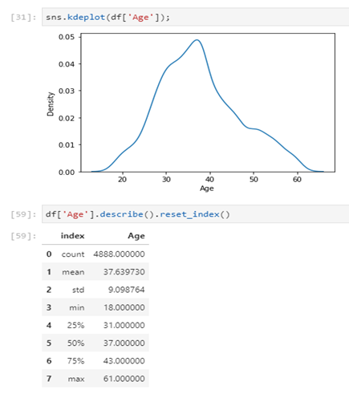
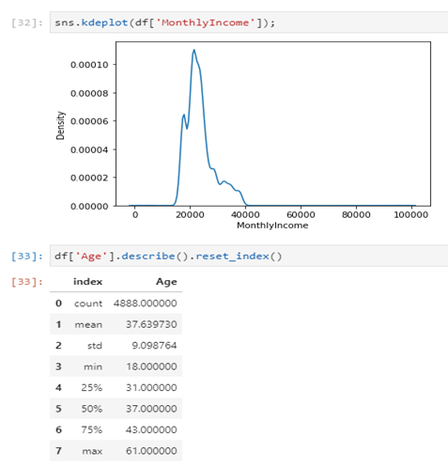
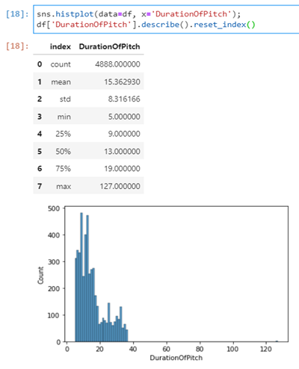
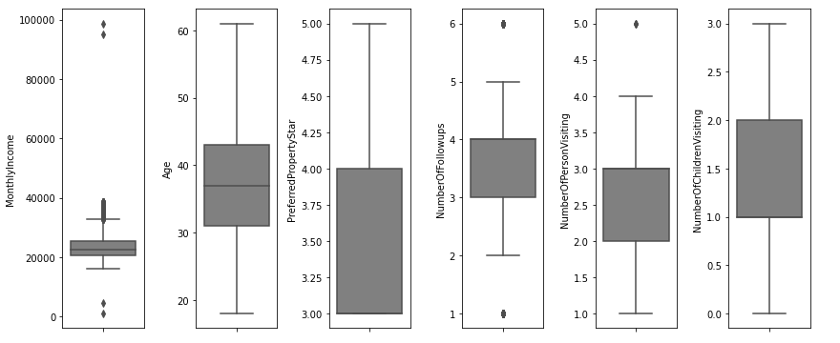
Pre-processing
DATA VISUALISASI

Slide 3
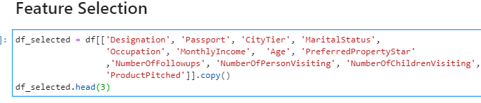
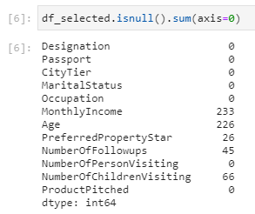
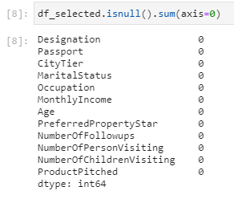
Pre-processing
Data Filtering
The feature that will be needed to build machine learning model are:
Based on the instruction :
Designation
Passport
Tier City
Martial status
Occupation
Monthly income
Age
Preferred Properties
Based on the correlation (above 0.3) :
Number Of Followups
Monthly Income
Age
Number Of Person Visiting
Number Of Children Visiting
Product Pitched
Designation
Product Taken
Missing values

Slide 4
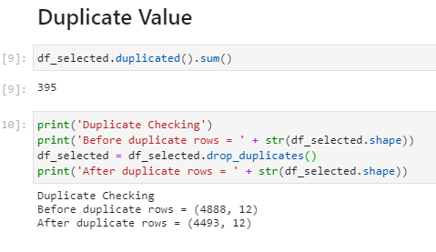
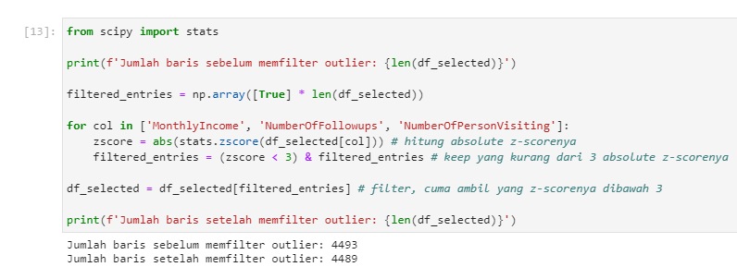
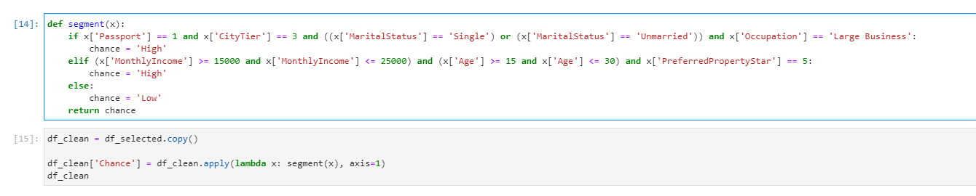
Data Cleansing
Handling Data Duplication
Handling Data with outlier using Z-Score above 3
Generate a Target column based on kaggle instruction

Slide 5
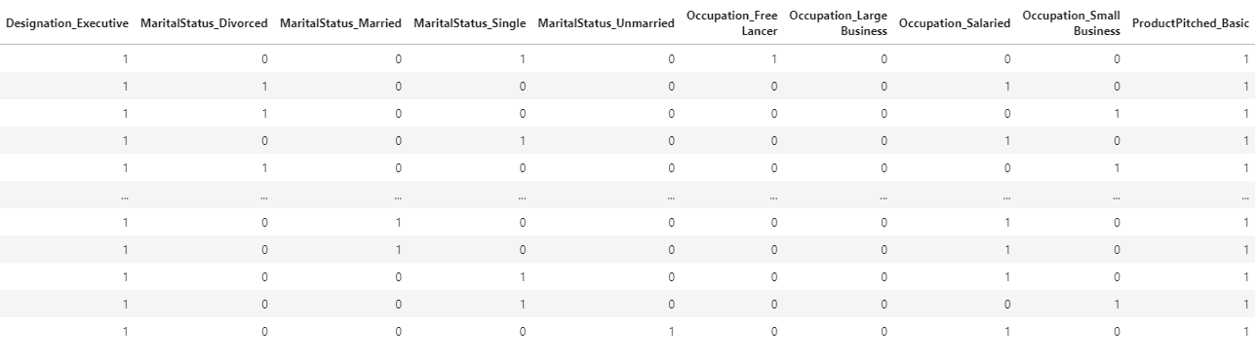
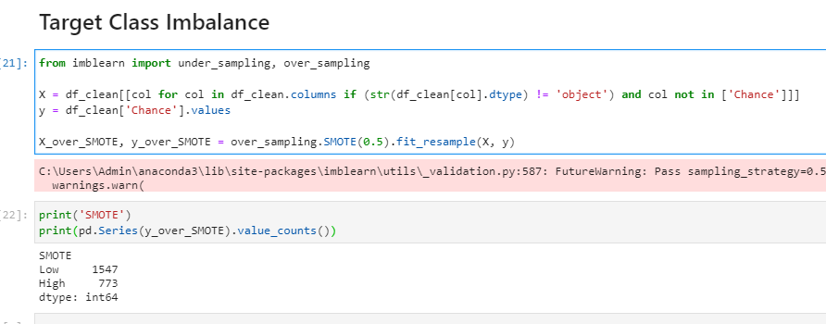
Pre-processing (Feature Encoding)
One hot encoding for categorical data
Class Balancing using SMOTE

